Slide 1
Chapter 2
Software Development Processes

Slide 2
Review
Software cost forms the major component of a computer system’s cost. Software is currently extremely expensive to develop and is often unreliable.
Software is not just a set of computer programs but comprises of programs and associated data and documentation. Each of these items is a part of the software engineering process. The main problems for software development currently are: high cost, low quality, and frequent changes causing change and rework.
Software has become a limiting factor in the evolution of computer-based systems. The intent of software engineering is to produce a framework for building higher quality software.

Slide 3
Objectives
Describe the importance of a phased approach to software development
List various phases involved in software development process
Describe how the various phases are organized into processes

Slide 4
A Phased Approach to Software Development
Consists of various phases
Each phase ending with a defined output
The phases are performed in an order specified by the process model

Slide 5
Development Phases – Why?
Breaks the problem of developing software into successfully performing set of phases
Each phase handles a different concern of software development
Allows proper checking of quality and progress at some defined points during the development
Ensures that the cost of development is lower

Slide 6
Classical Phases in Software Development
Requirement Specification
Analysis
Unit
System
Design
Acceptance
Implementation
Parallel Strategy
Testing
Direct Cutover
Pilot Study
Conversion
Phased
Maintenance

Slide 7
Phases in a Process Model
Requirement Specifications
Analysis
Design
Implementation
Testing
Conversion
Maintenance

Slide 8
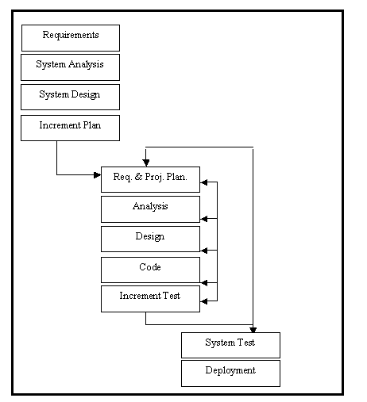
Phases in a Process Model Contd…

Slide 9
Software Development Processes
Development Processes
Project Management Processes
Software Configuration Management (SCM) Processes
Process Management Processes

Slide 10
Summary
A development process consists of various phases, each phase ending with a defined output.
The phases are performed in an order specified by the process model being followed.
The software development process goes through several phases:
  Requirement Specifications
  Analysis
  Design
  Implementation
  Testing
  Conversion
A process is a particular method of doing something, generally involving a number of steps or operations.
The Software development process consists of the following processes:
  Development Processes
  Project Management Processes
  Software Configuration Management (SCM) Processes
  Process Management Processes

